Slide 1
Ho-Chunk History in La Crosse
Notes:
All pictures from the Hear, Here website unless otherwise noted.
Ho Chunk is hyphenated when it is used as an adjective, but is not hyphenated when it is used as a noun. For example, “the community of Ho Chunk in La Crosse” is not hyphenated as Ho Chunk is the subject, but “the Ho-Chunk community in La Crosse” is hyphenated.

Slide 2
Lesson Road Map
Early Ho-Chunk History
Map of Ho-Chunk Lands
Ho-Chunk Culture
Basket weaving
Ho-Chunk Cemeteries
Art, Monuments, and Representation of the Ho Chunk in La Crosse
Hello in the Ho-Chunk Language:
Haho
(pronounced hah-hoh)

Slide 3
Early Ho Chunk History
Formerly known as the Winnebago Tribe
Once occupied all of Southern Wisconsin and Northern Illinois
Lost land to tribes, miners, and land succession treaties with the Federal Government
Forced migration to reservations in other states
Notes:
The Ho-Chunk Nation once occupied around eight million acres of Southern Wisconsin and northern Illinois, and were known as the Winnebago as they originated around Green Bay and Lake Winnebago. However, in the 1500s, the Ho Chunk began losing land to invasions by other tribes, resulting in fragmentation and a decline in population. This trend continued into the 1700s when miners began encroaching on Ho-Chunk territory in search of lead, even after peace treaties were signed by the Ho-Chunk Nation and the US Federal Government to stop the invasion of their land.
The early 1800s saw a series of land successions to the federal government, leading to eleven different removal campaigns that moved the Ho Chunk from their ancestral land to reservations in Iowa, Minnesota, South Dakota, and Nebraska. Despite these forced removals, some Ho Chunk refused to leave their homes, and the Ho Chunk of Wisconsin today are descendent of these people. Many students will be familiar with the Trail of Tears, where 16,000 members of the Cherokee Nation were forcibly removed from their land in 1817, resulting the death of an estimated 4,000 people. However, they may not realize that forced removal of Native American populations happened in Wisconsin as well. The land that the Ho Chunk occupy today are tribal lands that they have once owned, but have had to repurchase after their forced removal. The Ho Chunk do not have a reservation in Wisconsin.

Slide 4
Map of Ho-Chunk Lands
theways.org/map
Notes:
Visit theways.org/map for an interactive map of Ho-Chunk and other Native American lands in Wisconsin and surrounding states. If you click on “State Lines” and “Tribal Lands” students can see that La Crosse is located on Ho-Chunk land and that Ho-Chunk land extends farther northeast and into Illinois. An important point the text below the map makes is that all land in Wisconsin belonged to Native American tribes, and that the treaties that ceded the land from the Native Americans to the US government were one-sided. The US government took advantage of the Native American’s lack of English language knowledge and their ideas about communal land ownership that differed greatly from ideas about private land ownership.

Slide 5
Ho Chunk Culture
Ho Chunk means “People of the Big Voice” because of their language
Clan system with 12 different clans
Clan: group of people united by kingship or descent
The Ho Chunk do not have one reservation, but are located mostly in Wisconsin and Nebraska
The Ho-Chunk government is located in Black River Falls, WI, just 46 miles from La Crosse
Notes:
Ho Chunk means “People of the Big Voice,” because the Ho-Chunk language, or Hocąk language, is a parent language to over 15 others, all within the Siouian language family. Today, there are only around 200 fluent Ho Chunk speakers, but revitalization efforts have been ongoing, including at the La Crosse Youth and Learning Center, a center for Ho-Chunk youth near the La Crosse Public Library on Main St.
The Ho-Chunk Nation is comprised of twelve clans. A clan is a group of people united by kinship or descent. The first group of clans is Those-Who-Are-Above, which includes the Thunder, Warrior, Eagle and Pigeon clans. The second group is Those-Who-Are-On-Earth, which includes the Bear, Buffalo, Deer, Wolf, Elk, Fish, Water Spirit, and Snake clans. Each clan has distinct responsibilities within Ho-Chunk society, ranging from judicial matters, health, and government. Kinship and clanship in are different to the Ho Chunk than to other cultures, as Tracey Littlejohn will point out in her Hear, Here interview. This is demonstrated by the fact that there are over ninety terms to describe male kinship or relatives in the Ho-Chunk (Hocąk) language!
The Ho Chunk do not have a designated reservation like other Native American tribes. There are now two federally recognized, independent tribes that were once one tribe known as the Winnebago: the Ho-Chunk Nation of Wisconsin and the Winnebago Tribe of Nebraska.

Slide 6
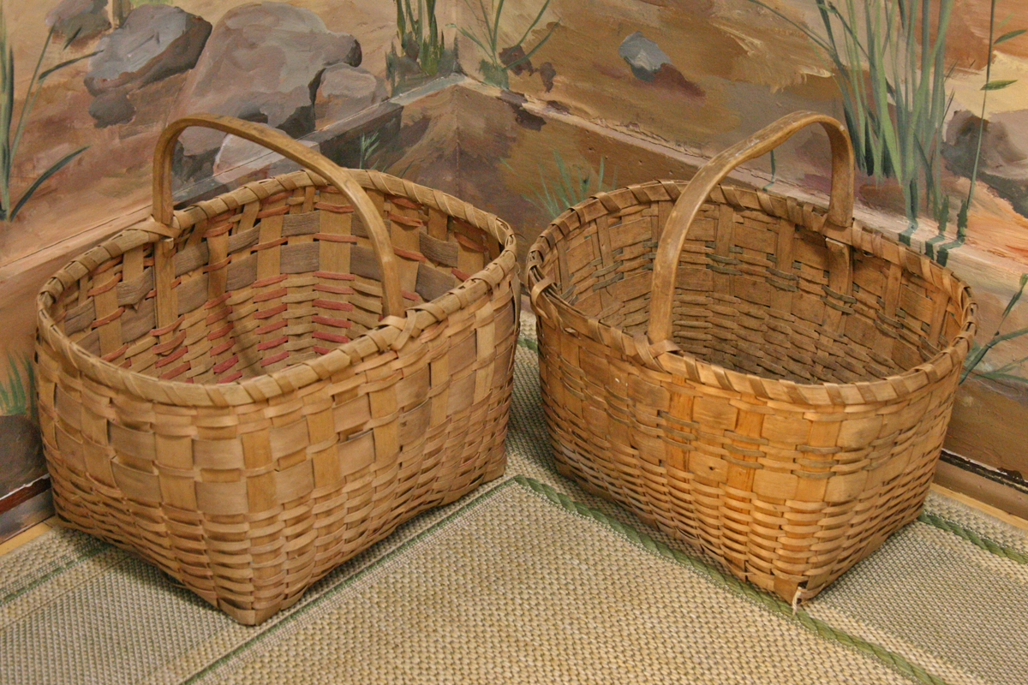
Basket Weaving
Traditional art form
Made from the black ash tree
“Woodsplit” method
Used for carrying goods, cooking and eating, carrying children, decoration, and many other uses
Sold to tourists and collectors
Notes:
Photo by Jim Hornby, Jackson County Historical Society, under Creative Commons license. Found at: https://myqei.org/ideas/imageideas_view.php?rid=38521.
The first Hear, Here story we will listen to discusses Ho-Chunk baskets. Basket making is one of the oldest of human crafts. Traditional Ho-Chunk baskets are made by soaking a log, most often from the black ash tree, in a lake or river. The log is then stripped of the bark, cut along the grain of the wood, and pounded down, before it is woven into baskets. This technique is known as the “woodsplit” form of basketry. These baskets can be used for carrying food and other goods, for food preparation and serving, as well as for decoration. Women traditionally wove the baskets, and more recently, women began selling their baskets to tourists and collectors to supplement income. In Tom Jone’s Hear, Here story, he mentions how women used to sell their baskets outside of Doerflingers department store, which is now Duluth Trading Company in downtown La Crosse. There are very few Ho-Chunk basket makers today, though people like Tom Jones, who is a professor at UW-Madison, collect baskets to preserve the art.

Slide 7
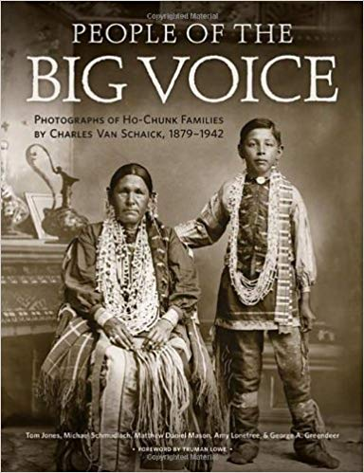
Hear, Here Story: Tom Jones
Tom Jones, an expert on Ho-Chunk basket weaving and a collector of baskets, describes this rare art form.
Notes:
Picture is of Tom Jones’s book, “People of the Big Voice,” available on Amazon.
Full transcript can be found at: http://www.hearherelacrosse.org/story/jones_tom_1/

Slide 8
Discussion
Why is it important that the Ho Chunk basket-making tradition be preserved? How is Tom trying to preserve the art?

Slide 9
Ho Chunk Cemeteries
Ho Chunk cemeteries have been found throughout the city of La Crosse, including at Myrick Park and at the Oktoberfest grounds
Many have been disturbed through expansion of the city
Today, archeologists and builders try to preserve the burials
Notes:
The next Hear, Here story we will listen to discusses the Ho Chunk burial grounds that are located at the current day Oktoberfest grounds. An article written by our next narrator, archeologist Ernie Boszhardt, describes multiple places where Native American burials have been found in the area, from the earliest description of a grave that we have records of by a military officer in 1817, to the excavation of ten graves recently from the parking lot of Petsmart in Onalaska. The article notes that Native American burials are not excavated unless they are in danger of being destroyed due to urban development. The article can be found at: https://archives.lacrosselibrary.org/local-history/cemeteries/native-american-cemeteries/.

Slide 10
Hear, Here Story: Ernie Boszhardt
Robert (Ernie) Boszhardt, an archaeologist of La Crosse and the surrounding region, identifies the former Ho-Chunk cemetery where the Oktoberfest grounds are now located.
Notes:
Full story at: http://www.hearherelacrosse.org/story/boszhardt_roberternie_1/

Slide 11
Discussion
How did archeologists know there was a Ho-Chunk cemetery on the Oktoberfest grounds? What would you do as an archeologist if you found this?

Slide 12
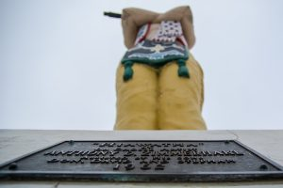
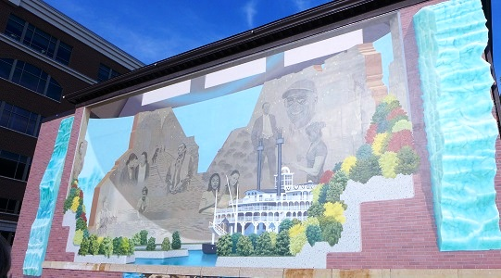
Ho Chunk Representation
Notes:
The next three Hear, Here stories address the representation of Native Americans in La Crosse. Native Americans are often portrayed as monolithic cultures that existed in the past, but not into present day. This type of representation negates the rich cultural and linguistic diversity between Native American groups, and ignores the vibrant Native American cultures still alive today. Students should think about how each of the monuments that will be described in the Hear, Here stories represent or do not represent the Ho Chunk in our area accurately and respectfully.
Elmer Peterson’s story describes how he made the Lacrosse Player’s statue to depict the game European settlers saw Native Americans playing in the area. Tracy Littlejohn’s story discusses the mural on the side of the Pump House, and why she felt that it represented La Crosse and its diversity well. Dan Green’s story discusses the Hiawatha Statue (also known as the Big Indian and the Colossus of Kitsch) and how it misrepresents Native Americans. Students should keep in mind how other cultures are represented in todays society, and how Native Americans are portrayed through art and monuments such as those in La Crosse, in preparation for a discussion after the three stories.
Picture of mural from: http://www.explorelacrosse.com/project_category/public-art/

Slide 13
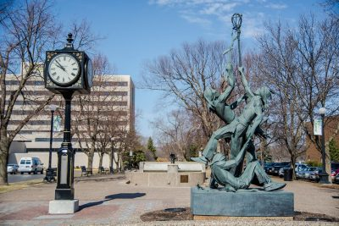
Hear, Here Story: Elmer Peterson
Elmer Peterson was asked to create a sculpture for the city of La Crosse and chose to depict lacrosse players to honor the history of the area.
Notes:
Full story/transcript at: http://www.hearherelacrosse.org/story/peterson_elmer/

Slide 14
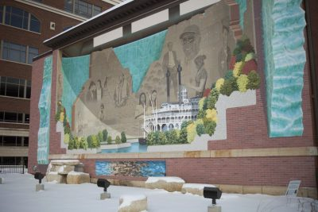
Hear, Here Story: Tracy Littlejohn
Tracy Littlejohn was involved in the process of bringing the trompe-l'oeil style mural to The Pump House and appreciated the efforts made to make the mural both historically and culturally reflective.
Notes:
Full story at: http://www.hearherelacrosse.org/story/littlejohn_tracy_1/

Slide 15
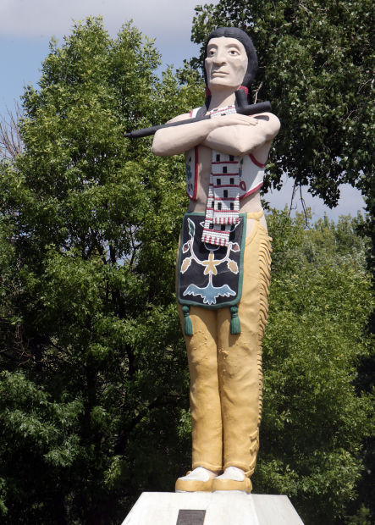
Hear, Here Story: Dan Green
Dan Green, also known as ­­­­­­­­­­­­­Kera Cho Mani ga, fights for Native American imagery, such as the Hiawatha statue in Riverside Park, to be updated to help combat stereotypes.
Notes:
Hiawatha Statue picture and background information on the statue can be found at: https://lacrossetribune.com/news/local/hometown-icon-hiawatha-statue/article_a0620862-2693-55ab-b50c-bef23fcd9ab7.html
To see Dan’s full story/transcript: http://www.hearherelacrosse.org/story/green_dan_1/

Slide 16
Discussion
How are Native Americans portrayed in media today? How does La Crosse portray the Ho Chunk through monuments?
Notes:
Other follow up questions as discussion progresses: Why is accurate, non-biased representation of Native Americans, and other minority groups, important? How would you feel if your culture was misrepresented? Why are Native American mascots problematic to Dan Green?

Slide 17
Conclusion- Think, Pair, Share
What is one thing that you learned from this lesson?
What is one thing that surprised or resonated with you from this lesson?
What is one thing you want to know more about after this lesson?

