Slide 1
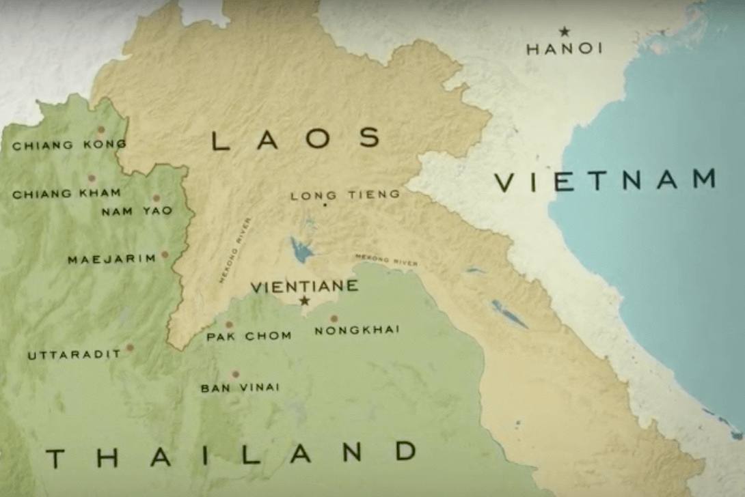
Ban Vinai Refugee Camp
Definition of a refugee: a person who has been forced to leave their country in order to escape war, persecution, or natural disaster
Ban Vinai Refugee Camp was the largest of the Hmoob camps in Thailand
Difficult living conditions
Notes:
Hmoob individuals who survived fleeing to the jungle and crossing the Mekong arrived in refugee camps in Thailand. The largest of these camps was Ban Vinai. While refugee camps are meant to be temporary, by 1986 life at Ban Vinai had become semi-permanent, with the average length of stay in the camp approaching seven years. Overcrowding, disease, and hunger were constant challenges.

Slide 2
Hear, Here Story: ChongCher Lee
ChongCher Lee is reminded of the uncertainty of life in the Ban Vinai Refugee Camp and the tremendous changes he has experienced throughout life.
This story’s recording is located at Hmong’s Golden Egg Rolls.
Notes:
ChongCher’s full story can be found at: http://www.hearherelacrosse.org/story/lee_chong_cher_1/?storyid=30167

Slide 3
Discussion
What was the significance of the picture of Ban Vinai Refugee Camp to ChongCher? Are there pictures that are important to you in your life?
Notes:
Follow up questions depending on student answers could include: What do these pictures represent for you? Do you have pictures that represent an uncertain time in your life? How do they make you feel?

Slide 4
Hmoob Immigration to La Crosse
90% of the Hmoob refugees from Laos were resettled in the United States.
184,000 Hmoob-Americans today
84% of Hmoob-Americans are in three states: California, Minnesota, and Wisconsin.
Notes:
Approximately 90% of the Hmoob refugees who fled Laos were resettled in the United States, owing to the alliance between the Hmoob and the U.S. during the Vietnam War. 84% of the Hmoob-American population is concentrated in just three states: California, Minnesota, and Wisconsin. There is estimated to be 184,000 Hmoob individuals in the United States. The last resettlement of Hmoob refugees from Thailand occurred in 2004.
Picture from: http://www.hmoobagency.org/
There are about 2,800 Hmoob individuals living in La Crosse county, as of 2014. Today, we have the Hmoob Cultural and Community Agency near Walmart

Slide 5
Hear, Here Story: Nauhoua (Tony) Yang
Nauhoua (Tony) Yang had to adjust from living in a refugee camp in Thailand to a city in America. Tony’s life in La Crosse started in a house on Vine Street, which he remembers fondly.
This story’s recording is located at the Corner of 10th St. and Vine St.
Notes:
Tony’s full story can be found at: http://www.hearherelacrosse.org/story/yang_nauhouatony_1/?storyid=30181

Slide 6
Discussion
What were some of the differences Tony listed between his life in a refugee camp and his life in America? Can you think of other differences that might exist that he had not named?

Slide 7
Hear, Here Story: Xong Xiong
The hardships of war that continue to affect the Hmoob community led Xong Xiong and other activists to protest the Iraq War by sitting in at Congressman Ron Kind’s office. Xong describes why she opposed the war, and how authorities handled the protest.
This story’s recording is located at 200 5th Ave South.

Slide 8
Discussion
How did the Hmoob experience with war influence Xong’s decision to protest? How does the way she thinks about war and experiences war compare to how you view or experience war?

Slide 9
Conclusion- Think, Pair, Share
What is one thing that you learned from this lesson?
What is one thing that surprised or resonated with you from this lesson?
What is one thing you want to know more about after this lesson?

