Slide 1
Hmoob History in La Crosse

Slide 2
Lesson Road Map
Hmoob Early History and Life in Laos
The Vietnam War
From Laos to America
Ban Vinai Refugee Camp
Hmoob Immigration to La Crosse
Hello in the Hmoob
Language:
Nyob Zoo
(pronounced Zyaw
Zhong)

Slide 3
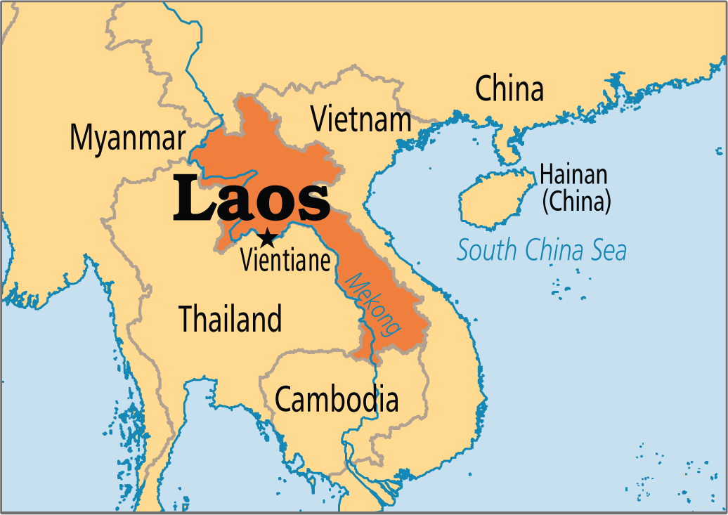
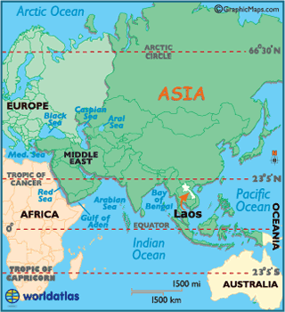
Laotian Roots
Hmoob, or Hmong, means “free people” in the Hmoob language.
Origins in China
Forced to move from China due to persecution
Most Hmoob people settled in Laos.
Notes:
Maps found at: https://www.worldatlas.com/webimage/countrys/asia/la.htm and http://www.laostourist.com/laos-geography/
Hmoob, the spelling of Hmong in the Hmoob language that will be used throughout this lesson, means “free people.” The Hmoob are believed to have originated from Mongolia, Siberia, or Tibet. They migrated to China and lived in China for almost 3,000 years, until facing persecution in China and moving to the highlands of Laos, Vietnam, and Thailand.

Slide 4
Hmoob Life in Laos
Slash-and-burn agriculture
Requires moving often
Small villages
Large extended families
Clan system: groups of families or households who share a common last name and common ancestors
18 Clans total in Hmoob society
Hmoob-Americans in La Crosse are from 11 different clans
Notes:
The Hmoob had lived in China for almost 3,000 years, before war and persecution forced them to flee China and settle in villages high in the mountains of Laos, Vietnam, and Thailand. The majority of the Hmoob settled in northern Laos.
The Hmoob traditionally used “slash-and-burn” agriculture, clearing the land for farming by cutting down trees and burning them. Common crops included rice, yams, potatoes, corn, squash, and cotton. Slash-and-burn agriculture ensured that the people remained fairly mobile, as this type of agriculture quickly depletes soil of its nutrients. The Hmong typically live in small villages with approximately 8 families, although these households can have as many as 50 people!
The Hmoob are traditionally organized by a clan system. The last name of an individual indicates their clan. There are 18 total clans in Hmoob society, 11 of which are in La Crosse. The 18 clan names include: Chang, Cheng, Chue, Fang, Hang, Her, Khang, Kong, Kue, Lee, Lor, Moua, Phang, Thao, Vang, Vue, Xiong, and Yang. The 11 clans that are represented in La Crosse include Change, Hang, Her, Lee, Lo, Moua, Thao, Vang, Vue, Xiong, and Yang. (Information on clans in La Crosse is from: Yang, NaoHoua (Tony). “The Hmong Among Us.” La Crosse School District. https://www.lacrosseschools.org/wp-content/uploads/2014/10/hmong-history-and-culture.pdf)

Slide 5
The Vietnam War
Vietnam War (1955-1975)
Laotian Civil War (1959-1975)
Many Hmoob fought on the side of the U.S. during the Vietnam War, against the communists in Vietnam.
The Hmoob were persecuted and forced to flee Vietnam after the end of the war
Notes:
The Hmoob were heavily impacted by the Vietnam War (1955-1975) and the Laotion Civil War (1959-1975). Thousands of families were forced to abandon their homes, possessions, and farms during the war, and many Hmoob died in the disruption the war caused.
Many Hmoob in Laos fought on the side of the United States during the Vietnam War, opposing the communists in Vietnam. General Vang Pao, a Hmoob leader, signed an agreement with the United States CIA to help the US fight the Vietnamese, including through rescuing American pilots, fighting the Vietnamese on the ground, and gather information about the Vietnamese. In exchange, the U.S. provided military supplies, food and shelter.
When the United States withdrew from the war and the Laos fell under communist control in 1975, life became dangerous for the Hmoob who had sided with America during the war, forcing the Hmoob to make the perilous journey to refugee camps in Thailand. Many individuals and families then came to America as from the camps in Thailand.

Slide 6
From Laos to America
Many made the perilous journey to refugee camps in Thailand, moving secretly through the jungle to the Mekong river, where they crossed into Thailand.
“Rules” of the jungle
Dangers of crossing the Mekong River
Notes:
Many Hmoob families were forced to flee their homes in the face of violence from Vietnamese communists after the Americans left Vietnam in 1975. Many made the perilous journey to refugee camps in Thailand, moving secretly through the jungle to the Mekong river, where they crossed into Thailand (map provided again on this slide). If your students attended the 4th grade field trip to the Hmoob Cultural and Community Agency for the Hmong Education Project, they may remember some of the rules of the jungle: stay in a line when moving through the jungle and hold on to the shirts of the people in front of you, cover your footsteps, only move at night, and do not cook food with campfires at night, for example. These rules reduced the risk of being found in the jungle by Vietnamese communists. At the border of Laos and Thailand, swimming across the Mekong river was especially dangerous, as many did not know how to swim. Floatation devices were made out of bamboo.

Slide 7
Hear, Here Poem: Mai Chao
Mai Chao’s poem “Two Rivers,” located in Riverside Park, serenades the Mississippi and the Mekong. Both rivers have been extant to joys and hardships. One is the past, the other is the present.
Notes:
This poem, by Mai Chao, contrasts her joyous experience being proposed to along the Mississippi with her mother’s experiences crossing the Mekong. Her mother “escaped certain death” by crossing the Mekong into Thailand (“the Land of Smiles”).
Mai’s story and the picture of the Missisippi can be found at: http://www.hearherelacrosse.org/story/chao_mai_1/. Mouse over the speaker icon to play a recording of Mai reading her poem.

Slide 8
Discussion
How does Mai Chao’s experience with the Mississippi River contrast to her mother’s experience with the Mekong River?

