Slide 1
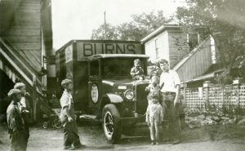
Sarah Jane Fellows
Click to listen to
Sarah’s story.
Notes:
Click the icon to the story.
It can also be accessed on the Hear, Here website:
http://www.hearherelacrosse.org/story/fellows_sarah_jane_1/
Optional-Artful Thinking: Ask students to look at the image. What do they see? What do they wonder about the picture (do they have questions about what they see?). What do they think is happening in the picture?

Slide 2
Questions
What types of animals would Sarah find at her grandfather’s business?
What was the business that Sarah’s grandfather had?
How did Sarah feel in her story?
What did the river bring Sarah and her family?
Notes:
These questions will check for immediate recall as well as making deeper connections to the meaning of the river to different individuals (preparing them for the activity at the end of the lesson).
What types of animals would Sarah find at her grandfather’s business?
Snakes and spiders
What was the business that Sarah’s grandfather had?
He sold bananas (and some other foods)
How did Sarah feel in her story?
Answers will vary based on how students interpreted the story. They might say she had fun and enjoyed working with her grandfather and the bananas. Students might say scared because of the spiders and snakes. Let them give their own answers and explain their interpretation.
What did the river bring Sarah and her family?
Answers can vary. This may take some time for students to think about as it is not stated clearly in the story. In the most literal sense, they are getting bananas. They could also say food, resources, or even income/revenue.

Slide 3
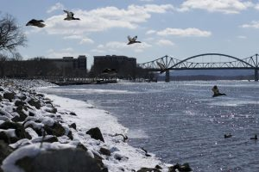
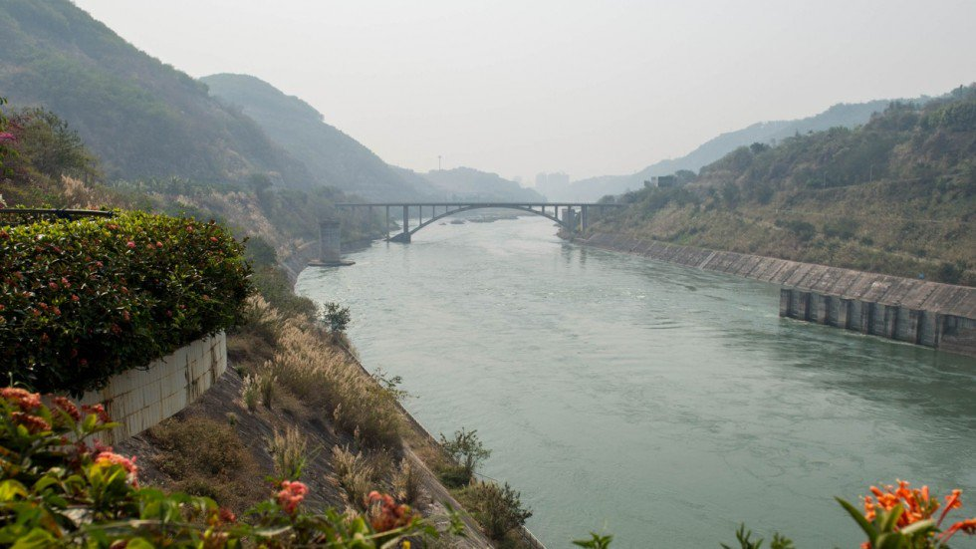
Mai Chao
Left: Mississippi River
Below: Mekong River
Click to listen to
Mai’s story.
Notes:
Click the icon to listen to Mai’s story.
The story can also be accessed on the Hear, Here website:
http://www.hearherelacrosse.org/story/chao_mai_1/
Optional-Artful Thinking: Ask students what the see in each image. What do they wonder (what questions do they have)? Do they see any similarities between the images? How about differences?

Slide 4
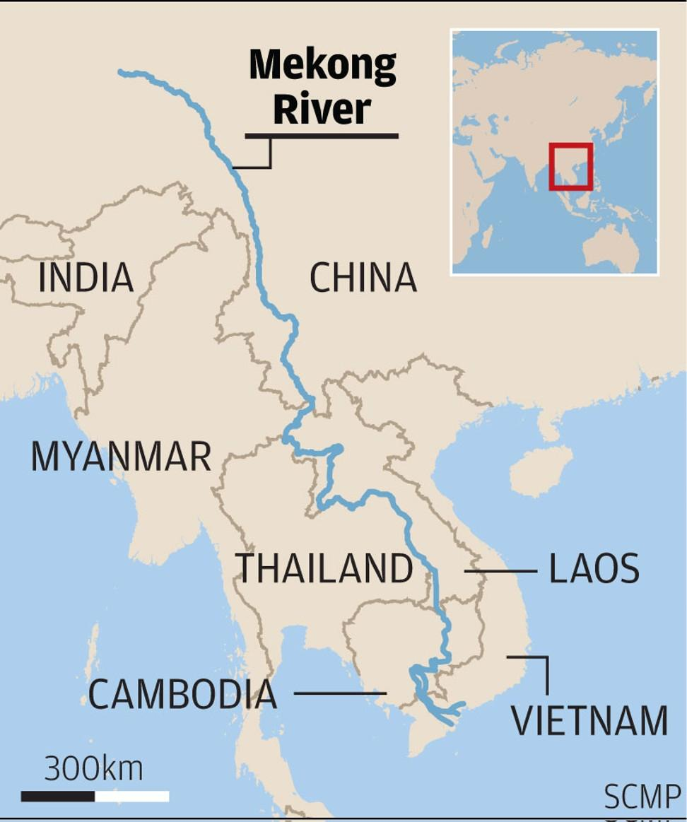
Questions
Where are Mai and her mother from?
How does she make connections between the Mekong and Mississippi Rivers?
How did Mai feel in her poem?
What did the river(s) bring Mai?
Notes:
These questions will check for immediate recall as well as making deeper connections to the meaning of the river to different individuals (preparing them for the activity at the end of the lesson).
Where are Mai and her mother from?
Laos. Students may mention the Vietnam War. If this has been discussed previously, expand on this and make connections.
How does she make connections between the Mekong and Mississippi Rivers?
Mai makes connections between her mother’s experiences along the Mekong with her own along the Mississippi. Both of them had life changing experiences in front of these rivers. Her mother contemplated her future as she fled Laos for Thailand before coming to America. Mai’s husband proposed to her in front of the Mississippi River. Both of these rivers helped lead them in new directions in their lives.
How did Mai feel in her poem?
Answers will vary based on how students interpreted the poem. Some answers may include nostalgic, since she is looking back on past events. They may say happy since she is talking about her engagement and her mother starting a new life in America. They may say sad if they are thinking more about her mother having to flee her home country.
What did the river(s) bring Mai?
Answers will vary. Students will need to think more abstractly as this poem is primarily about memories and emotion. They may say that the river brought her happiness during her engagement. The river also brought her memories from the past as she looks back on her engagement and her mother’s experiences as a refugee. It brings her hope for a better future. It brings her life (the repeated mention of the river’s “heartbeat”).

Slide 5
What does the Mississippi River mean to you?
Notes:
Hand out a sheet of blank paper and a sheet of lined paper to each student. Set up any necessary art materials.

Slide 6
River Art and Story Activity
Pick a specific place where you’ve had a special experience involving the Mississippi River. This could be Riverside Park, Pettibone Beach, a time you went on the river in a boat, or a time you looked out at the river from Grandad’s Bluff or in a car driving by.
Make an art piece of that place and moment. Be creative. This can be a literal picture, or something that shows your emotions and feelings during the experience. Be sure to label important details of the picture (the river, the name of the location, a date if you have one, important buildings or people you’ve included). Along with your art piece, include a paragraph explaining the experience (set the scene and have a beginning, middle, end) and why you chose that experience. Also include what the river meant to you or brought you in that experience (feelings and emotions).
Notes:
Read students the prompt above. This will give them an idea of where the activity is going.

Slide 7
Share Your River Art and Story!

