Slide 1
Mapping
La Crosse
Notes:
This lesson works best in conjunction with the lesson “Hear, Here: Mississippi River Lesson Plan,” but can be done alone. If doing the lessons together, start with the “Mississippi River” lesson before starting this “Mapping La Crosse” lesson.

Slide 2
Lesson Road Map
Using Maps-the basics
Name that map!
Activity: Create a map of Riverside Park
Notes:
This lesson has three main parts. The first section, “Using Maps-the basics” is about understanding the basic components of maps and why they are used. This is a shorter activity that will be expanded on in the second section, “Name that map!” In the second section, students will look at three different maps and will need to identify its type and the parts (discussed in the first section). This will help give them a clearer understanding of these elements of maps and how they are used. In the final activity, students will create a map of Riverside Park. This map will be used in Day 2 of this lesson, which is a field trip to Riverside Park.
Depending on instructors needs, resources, and time, this lesson can be done in Riverside Park. Students could create a map ahead of time of the park and then mark the stories and other significant places on it during their trip. The students could go to the different stories and listen to them using a cell phone. They could then create their own story about what the river means to them.

Slide 3
Using Maps

Slide 4
Map Basics
What is a map?
What are maps used for?
What types of things can you find on a map?
Can you think of different types of maps?
Have you used a map? When? Why? What was your experience like?
Notes:
What is a map?
A drawing of all or part of earth’s surface.
What are maps used for?
Maps are used to show where things are. They help people understand their environment or surroundings.
Maps make it easier for people to travel, trade, and communicate with each other about their physical space.
What types of things can you find on a map?
Natural features (rivers, oceans, mountains, etc.), man-made features (buildings, roads, etc.), boundaries of cities/states/countries
*If mentioned, maps should also have a legend, the cardinal directions, orientation, labels, and scale (this will be covered on the next slide)
Different types of maps?
Political maps (those that show city, state, or national boundaries of a place, such as a map of the U.S., a map of the countries of the world, or a map of Wisconsin that shows the different counties)
Physical maps (landscape features, such as bodies of water, mountains, elevation, forests, etc)
Topographic maps (show changes in elevation using contour lines)
Climate maps (could show differences in rainfall, snow, temperature, etc. by using different colors)
Road maps (show the major roads and highways; can be of cities, states, or countries, or even of smaller areas like a trail map of a park).
*Physical, Political, and Special Interest Maps are categories frequently used. Climate Maps, Population maps, agriculture maps, etc would fall under “Special Interest”
Have you used a map? When? Why? What was your experience like?
This question is meant to get students to make connections to their own lives. Answers will vary. You may need to provide your own example of a time you’ve used a map to help get them going.

Slide 5
Features of a Map
What different elements should maps have to make them easy to use and understand? In other words, if you were using a map, what would you want it to have so you could use it?
Notes:
Get the students thinking about what features a map needs to be effective. If they are having trouble with this, ask them some questions to get them started. This could include: What would you need to know what the map is of? How would you identify the little symbols and parts of a map? How would you know which way to go (get them to think of directions like North, South, East, West)?

Slide 6
Features of a Map
Title
Legend/Key
Compass Rose/Orientation
Scale
Labels
Author name and date
Notes:
Listed here are the main features of a map. These are also features the students should be including on their own maps. Explain what these terms are and why they are important:
Title
This will let the person using the map know what they are looking at.
Legend/Key
The legend or key explains what the symbols are on the map (for example: cities, trees, monuments, etc). Without it, the user will not know what certain elements on the map are.
Compass Rose/Orientation
This lets the person using the map know which direction the map is facing. A map without a Compass Rose or other orientation (i.e. a north arrow) would be useless.
Scale
This lets the user know how much area the map is covering and how far it is from one point on the map to another.
Labels
Labels are needed to explain what key areas are. Have the students imagine what a map would be like if roads, bodies of water, buildings, mountain ranges, etc. were not labels.
Author name and date
It is important to know who created a map, just as it is important to know who creates any source you use. The date is important as elements on a map can change (i.e. change in landscape, construction, new monuments etc.).

Slide 7
Name That Map!
Notes:
The next three slides have three different types of maps. Ask students to identify what type of map it is, what types of things the map shows, and what key features they see.

Slide 8
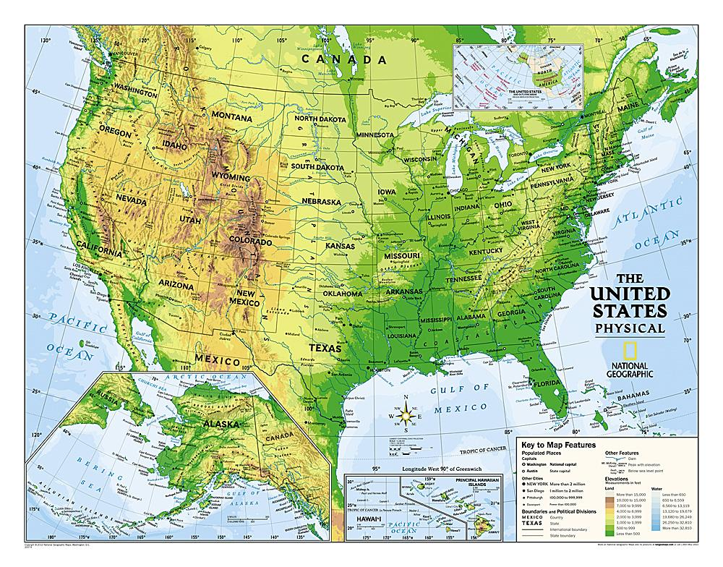
Notes:
This is a physical map of the U.S.
Ask the students: What type of map is this? What types of things does this map show?
Features to point out: title, compass rose, legend/key, scale, source/author, grid
*Have students come up to the picture and point to specific elements they see.

Slide 9
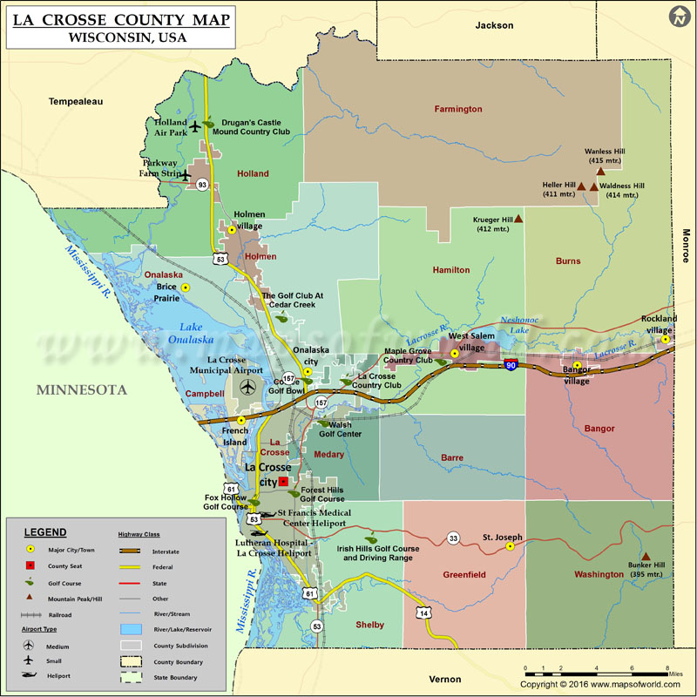
Notes:
This is a political map of La Crosse County
Ask the students: What type of map is this? What types of things does this map show?
Features to point out: title, directional, legend/key, scale, source/author
*Have students come up to the picture and point to specific elements they see.

Slide 10
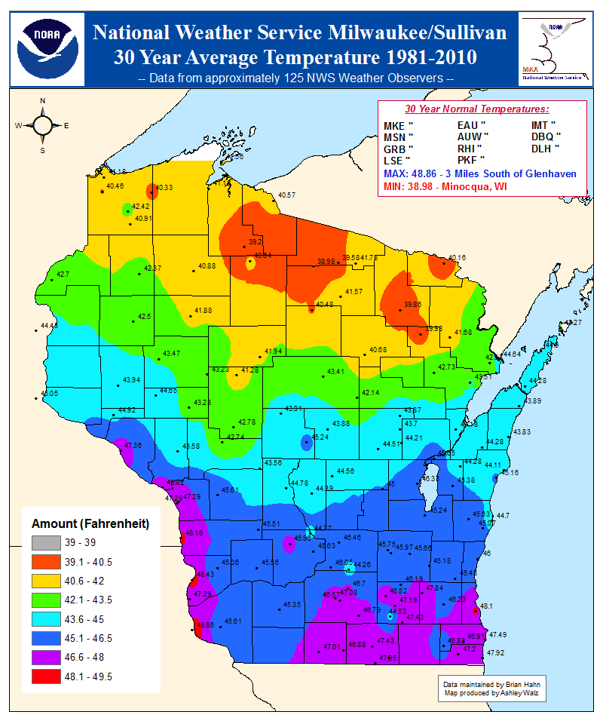
Notes:
This is a special interest/climate map of Wisconsin
Ask the students: What type of map is this? What types of things does this map show?
Features to point out: title, compass rose, legend/key, scale, source/author
*Have students come up to the picture and point to specific elements they see.

Slide 11
Make a Map of
Riverside Park!
Notes:
Hand out the paper to students. They should get a legal size for their maps and a 8.5x11 to use for their legend/key. Set up any necessary art materials.

Slide 12
Maps
Today, you will create the main elements of your map. This includes:
Title
The general landscape of the Mississippi River, La Crosse River, and Riverside Park/land (be sure to label these!)
The main roads
Compass rose
A sheet to be your legend or key
Author and date
Notes:
The students will be creating a map to use on their field trip to Riverside Park in Day 2. This activity will allow students to apply what they have learned about basic map features to an area they should be at least somewhat familiar with. On the field trip they will need to label more detailed aspects of the park on their map.

Slide 13
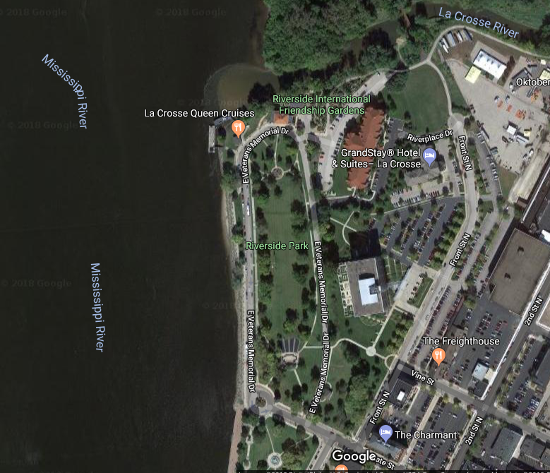
Notes:
Here is a satellite picture from Google Maps. Feel free to pull this up using Google Maps on your own (it may be better quality). The orange box shows the area the students should concentrate on. The rest of the image helps give them context (it also has the labels for the rivers).

Slide 14
Next Up: Field Trip!
Keep your maps! We will be using them during our field trip to Riverside Park in downtown La Crosse
What will you be doing?
Navigating the park in groups
Adding more features to your maps, such as Hear, Hear stories, monuments, and the Friendship Garden
Sharing your maps with your classmates
Why are we doing this?
To apply our new knowledge of making maps to a place in our own community
To get to know our natural and built environment
Notes:
This slide will help students get an idea of what they will be doing on the field trip. It is helpful for students to have an understanding of what they will be doing and why, which can increase their ability to learn and retain information on the trip. This is also a great time to take any questions they have about the mapping activity and the field trip, which should better prepare them for the small group activity in the park.

