Slide 1
Mississippi River
Notes:
This lesson will cover the basic features of rivers as a water system on Earth’s surface, the geography and cultural history of the Mississippi River, and the meaning the river has to individuals in La Crosse. The lesson utilizes three Hear, Here stories to help students make connections between the Mississippi River and the people of La Crosse, or in other words, how the natural environment has affected the culture and people of the city.
This lesson works well in conjunction with the lesson “Hear, Here: Mapping La Crosse Lesson Plan” (Days 1 and 2) This lesson should be done first, with the next 2 day Mapping La Crosselesson and field trip following. However, both lessons can be done alone.

Slide 2
Lesson Road Map
Mississippi River and La Crosse
What does the river bring us?
Hear, Here stories about the importance of the Mississippi
Activity: What does the Mississippi River mean to you?
Notes:
Depending on instructor’s needs, resources, and time, this lesson can be done in Riverside Park (see Mapping and Geography Lesson Plan-Field Trip (Day 2). Students would create a map ahead of time of the park and then mark the stories and other significant places on it during their trip. The students would go to the different stories and listen to them using a cell phone and mark aspects of the stories on their maps.

Slide 3
Mississippi River and La Crosse
Notes:
Pose the following questions for a discussion on the Mississippi River and La Crosse, Wisconsin:

Slide 4
Water and the Earth
Water is a very important resource for humans on earth
What are some different water sources?
Where is most of earth’s water located?
Where is most of earth’s freshwater located?
Notes:
These questions are meant to prepare students for the following discussion on a particular water system: rivers. These questions place river systems in the larger context of earth’s water systems.
Ask students the questions on the slide:
What are some different water sources: oceans, rivers, lakes, streams, ponds, etc. This is meant to be an open question, so accept answers that are given even if they veer off of earth’s physical water systems.
Where is most of earth’s water located: Oceans
Where is most of earth’s freshwater located: glaciers or underground.
This will likely be difficult for students. Encourage them to think through different possibilities. For example, would oceans be considered freshwater? Why not? If a student says rivers, have them think about how much of the surface area of earth is covered by rivers. Does it seem like a lot? Pull up a map (Below is a link to a National Geographic map showing complete river systems and watersheds on earth). If students say lakes, ask them if they know what the largest freshwater lake in the world is (Lake Superior by surface area). They may not know that they live relatively close to this significant lake. Show them a picture of the Great Lakes. Do these take up a lot of earth’s surface? After going through these more well known and visible water systems, ask students “If none of these are it, what else could it be? What might we not be able to see where we are?” Mentioning well water, and asking if any of them are familiar with it or use it, may also help get them to the answer of underground or glaciers.
https://www.nationalgeographic.org/hires/world-rivers/

Slide 5
Let’s Talk About Rivers!
Today, we’re going to talk about rivers!
What do you know about rivers?
What are the pieces or parts of rivers? What are their purposes?
What do you want to know about rivers? What questions do you have?
Notes:
Inform students that today you will be talking about rivers.
Ask students the general question: What do you know about rivers? Accept all answers.
Get the students thinking deeper about rivers by using a pieces, purposes, and puzzles exercise. These questions are not meant to have answers, but instead are used to get students thinking more critically about the topic of rivers.

Slide 6
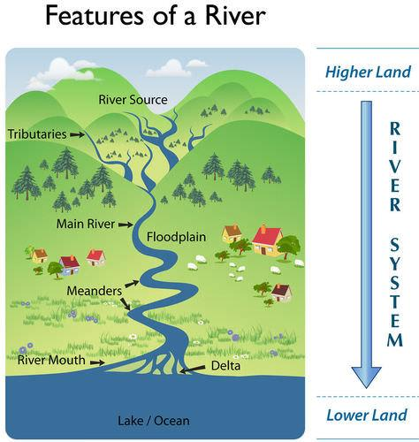
Learning about Rivers
Words to Know!
A river is a flowing, moving stream of water. Usually a river feeds water into an ocean, lake, pond, or even another river.
What is a river source?
Floodplains are low flat land along a stream that is flooded when the stream overflows.
A drainage basin or watershed is an area of land where all of the water that is under it, or drains off of it collects into the same place (e.g. The River).
A tributary is a stream or river that flows into and joins a main river. It does not flow directly into the sea.
A meander is a curve in a stream or river.
A river delta forms from deposition of sediment carried by a river as the flow leaves its mouth and enters slower-moving water. This occurs where a river enters an ocean, sea, estuary, lake, or reservoir.
Notes:
Go over the important words listed in the slide. These are basic words that will help students understand river systems. If you have previously covered rivers or other natural landscapes, make references to that to help the students connect these ideas.
First, write the following seven words on the board: river, river source, floodplain, watershed/drainage basin, tributary, meander, river delta. Going in order, ask the students if they know what they mean. While they may say things like “a river delta is part of a river,” try to get them to provide more concrete definitions. As you go through each word, pull up the definition on the slide. Use the image on the right side of the slide to give the students a visual understanding of the parts of a river.

Slide 7
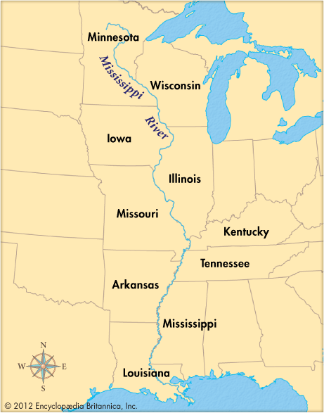
Mississippi River
Geography
The Mississippi River basin was formed by glaciers millions of years ago.
Lake Itasca in Minnesota is the primary source of the river.
The Mississippi River empties into the Gulf of Mexico.
It has the second largest watershed in the world!
History
The word “Mississippi” comes from the word “Messipi” which means “Big River” in Ojibwe.
Native Americans used the river for transportation, hunting, and fishing.
The river was our nation's western border until , and expansion west of it was a turning point in our history.
The Louisiana Purchase (1803): The U.S. gained land west of the Mississippi River from France
President Thomas Jefferson created a unit of the United States Army called the Corps of Discovery to learn about the plants, animals, and geography of the newly acquired Louisiana Territory. The Corps were led by Captain Meriwether Lewis and Second Lieutenant William Clark from 1804-1806.
Notes:
This slide is to help the students understand the Mississippi River specifically. The first portion (“Geography”) makes connections to the previous slide. An image of the Mississippi River is included. Pull it up so students can understand the location, length, and important geographic features of the Mississippi River.
The second portion (“history”) will help students understand the cultural and historical meaning of the river. If you have previously covered the Westward Expansion in another lesson, make those connections here. If not, and if time allows, feel free to expand on the ideas of the Louisiana Purchase and Corps of Discovery. Additional materials have been provided.
Question to ask the students: How has the natural physical history of the Mississippi River affected the cultural history America? How about La Crosse?

Slide 8
What does the river bring us?
Notes:
This short section is meant to get students thinking about the deeper meaning of the river and how humans living within its floodplain have interacted with it.

Slide 9
Why is the river important to the community of La Crosse?
What types of resources do we get from the river?
Who/what travels on the river?
How do we use the river?
How does the river make us feel?
Why do we need the river?
Notes:
This is meant to be a brainstorming activity. It should get the students thinking about how the river has been utilized by humans living along it. For many students, thinking about the river as more than just a body of water may be difficult. These questions should help get them thinking about the river’s purpose and meaning to the La Crosse community.
Potential answers to the listed questions are as follows (these will vary):
What resources do we get from the river?
Fish, other animal life, rocks and minerals, clams
Who/what travels on the river?
Boats (ask the students: what kinds? What do they bring?), people, animals
How do we use the river?
To get resources, to have fun, to travel, for tourism
How does the river make us feel?
This is a subjective question. Ideally, students will be able to connect their own experiences with the river to this question. Maybe looking at or spending time by the river makes them happy, or maybe they had a not-so-great experience by the river that this question reminds them of. The goal is for them to see how the river can have an emotional impact on those that visit it.
Why do we need the river?
This question should get the students to connect all of the previously discussed ideas. We need the river for resources, travel, recreation and tourism, and because it helps create experiences, memories, and emotions.

Slide 10
Hear, Here Stories
Notes:
Give a brief description of what oral history is. Oral histories are recordings of people’s true stories. They are done with an interviewer who has questions about a particular time or event in a person's life. These individual stories help make events in history come alive.
They are important because they provide first person narratives of experiences. Sometimes when we talk about events in the past, it is easy to feel disconnected from them and the people that lived through these experiences. Oral histories help us feel connected to those people and events, even if we weren’t there ourselves. They also help historians preserve these stories for future generations.

Slide 11
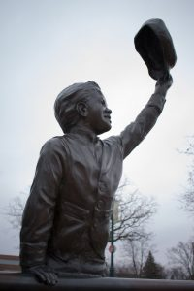
Shawn Micallef
Click to listen to Shawn’s story.
“A Simpler Time” Statue in Riverside park
Notes:
Click the icon to listen to Shawn’s story.
The story can also be accessed by the website:
http://www.hearherelacrosse.org/story/micallef_shawn_1/

Slide 12
Questions
What time of day was Shawn in the park?
What did Shawn see in the park?
How did Shawn feel in his story?
What did the river bring Shawn?
Notes:
These questions will check for immediate recall as well as making deeper connections to the meaning of the river to different individuals (preparing them for the activity at the end of the lesson).
What time of day was Shawn in the park?
Nighttime (specifically 11:30pm)
What did Shawn see in the park?
He saw a barge going down the river that had its spotlight on.
How did Shawn feel in his story?
Answers will vary based on how students interpreted the story. They might say nervous because he was in the park after hours. More likely, they will say happy (or something similar) because he enjoyed watching the barge and having the spotlight flash at him.
What did the river bring Shawn?
Again, answers will vary. That’s okay; encourage it. Students may say happiness, fun, entertainment, enjoyment, a warm welcome to La Crosse, etc.

