Slide 1
Hear, Here Inspired
Narrative Writing:
Example Narratives

Slide 2
Activity Objectives
Listen to Hear, Here stories to familiarize ourselves with the structure of the stories in preparation for writing our own personal narrative.

Slide 3
What makes a good Hear, Here story?
A beginning, middle, and end
About a specific event or story that took place at a specific place
The setting should have an address attached to it
The narrator experienced the story firsthand

Slide 4
What makes a good Hear, Here story?
Includes enough details about the event and place to make the story seem real
A deeper meaning or message to the story explained in the conclusion of the story
Ends with your name, and your role in the community, or your interests, passions, or another fact about your identity

Slide 5
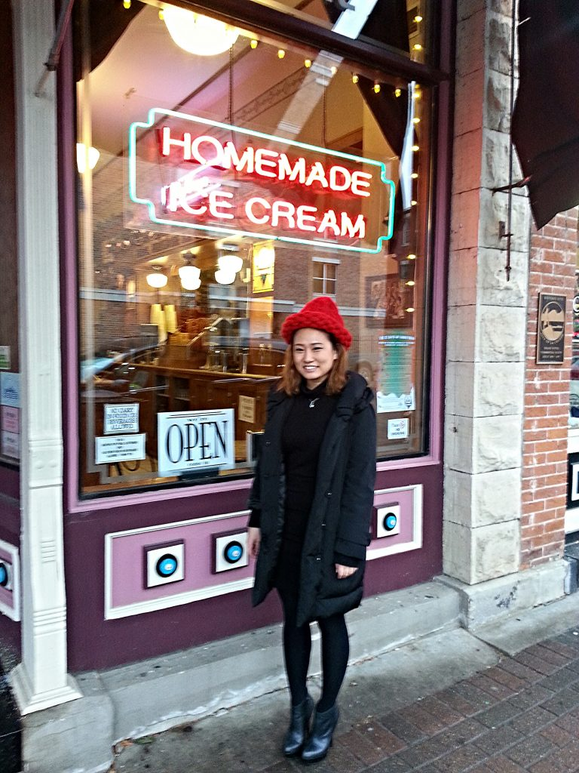
Hear, Here Story: Rina Jong
As an international student studying in La Crosse, Rina Jeong was extremely excited to go to The Pearl Ice Cream Shop, but she encountered some challenges as a non-English speaker in a new country.
Rina at The Pearl.
Notes:
Rina’s story transcript can be found at: http://www.hearherelacrosse.org/story/jeong_rina_1/?storyid=29304
Click on the audio button to listen to the story.

Slide 6
Discussion
How did Rina introduce the setting of her story?
What elements of Rina’s story can you use as an example in your own?
Notes:
Note that all of the Hear, Here stories are from oral history interviews, edited from a conversation, and so the grammar and sentence structure of the stories will not be as formal as your student’s narratives.

Slide 7
Hear, Here Story: Robert Boszhardt
Ernie has worked as an archaeologist in the region since 1982. When the city of La Crosse was being developed in the 1860s, multiple Ho-Chunk artifacts were found. A copper axe indicated that the land was used for a sacred purpose.
Notes:
Robert’s story transcript can be found at: http://www.hearherelacrosse.org/story/boszhardt_roberternie_1/?storyid=30154
Click on the audio button to hear the story.

Slide 8
Discussion
What details does Robert provide in this story?
What elements of Robert’s story can you use as an example in your own?

Slide 9
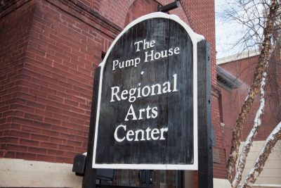
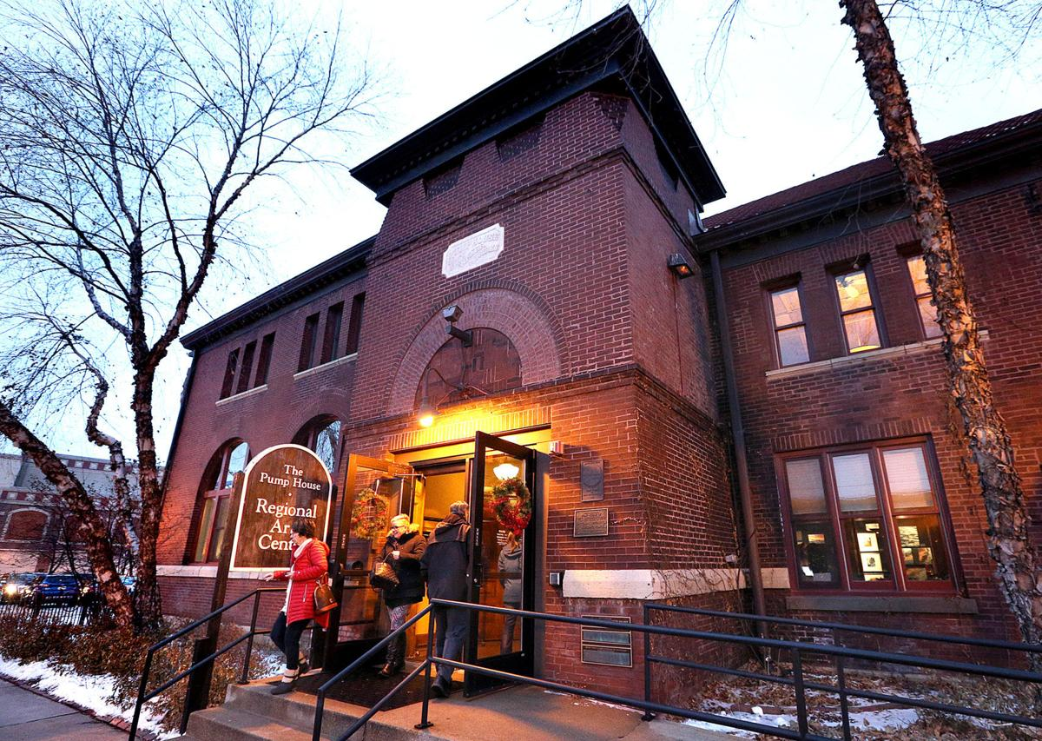
Story #5: Homelessness and The Pump House
After becoming Executive Director of The Pump House, Toni Asher had her first personal experiences with the problem of homelessness in La Crosse.
The outside of the Pump House.
Notes:
Photo on the right from The La Crosse Tribune: http://lacrossetribune.com/entertainment/at-pump-house-in-la-crosse-aims-to-be-on/article_79ece2bf-5dea-5fcb-b0de-cf45b89319ba.html
Toni’s story transcript can be found at: http://www.hearherelacrosse.org/story/asher_toni_1/?storyid=29338
Click on the audio button to listen to the story.

Slide 10
Discussion
How did Toni state the significance of her story? What is that significance?
What elements of Toni’s story can you use as an example in your own?

Slide 11
Topic/Setting Brainstorm
Notes:
Remind students that the story topic/setting should be:
About something they experienced personally
Tied to a specific place with an address or GIS coordinate
And if their story takes place in downtown La Crosse, they can submit their story to become a Hear, Here sign at: http://www.hearherelacrosse.org/submit-story/

